Slide 1

13 Colonies
Life in early America
Objectives/Standards:
Describe the contributions of geographic and economic conditions, religion, and colonial systems of government to the development of American democratic practices.
Describe the geography, cultures, and economics of the Southern, Middle Atlantic, and New England Colonies.
Describe interactions (e.g., agricultural and cultural exchanges, alliances, conflicts) between Native Americans and European settlers.

Slide 2
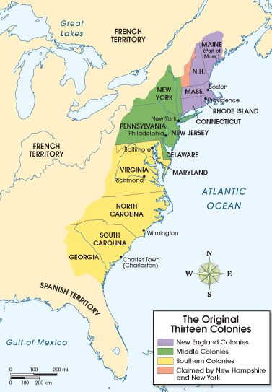
The Colonies
Each colony was unique in it’s characteristics. However, they are grouped together based on location, reasons they were founded, and what types of industries they had.
New England Colonies
Rhode Island
Connecticut
Massachusetts
New Hampshire
Middle Colonies
Delaware
Pennsylvania
New York
New Jersey
Southern Colonies
Maryland
Virginia
North Carolina
South Carolina
Georgia

Slide 3
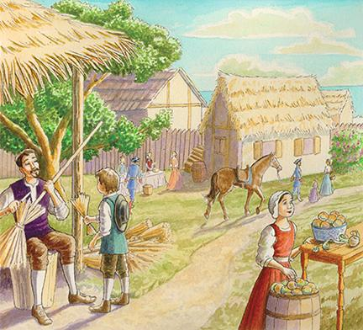
New England Colonies

Slide 4
Vocabulary
Frontier– What is a frontier?
Lands beyond the areas already settled.
Colonists would expand their settlements beyond what was already colonized by heading in a westerly direction. Sometimes this expansion would cause conflicts with Native Americans.
Charter – What is a charter?
An official paper.
Settlers had permission from the King of England to start colonies in America.

Slide 5
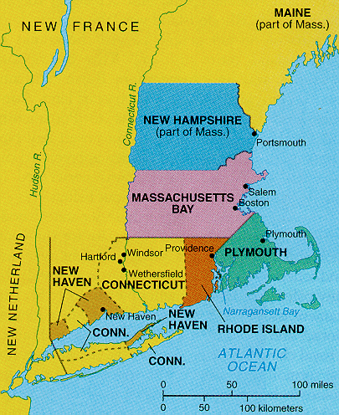
New England Colonies
The settlers here wanted to keep their family together and practice their own religions.
They were used to doing many things themselves and not depending on other people for much.
Some were looking for economic opportunities. Some starting fishing settlements

Slide 6
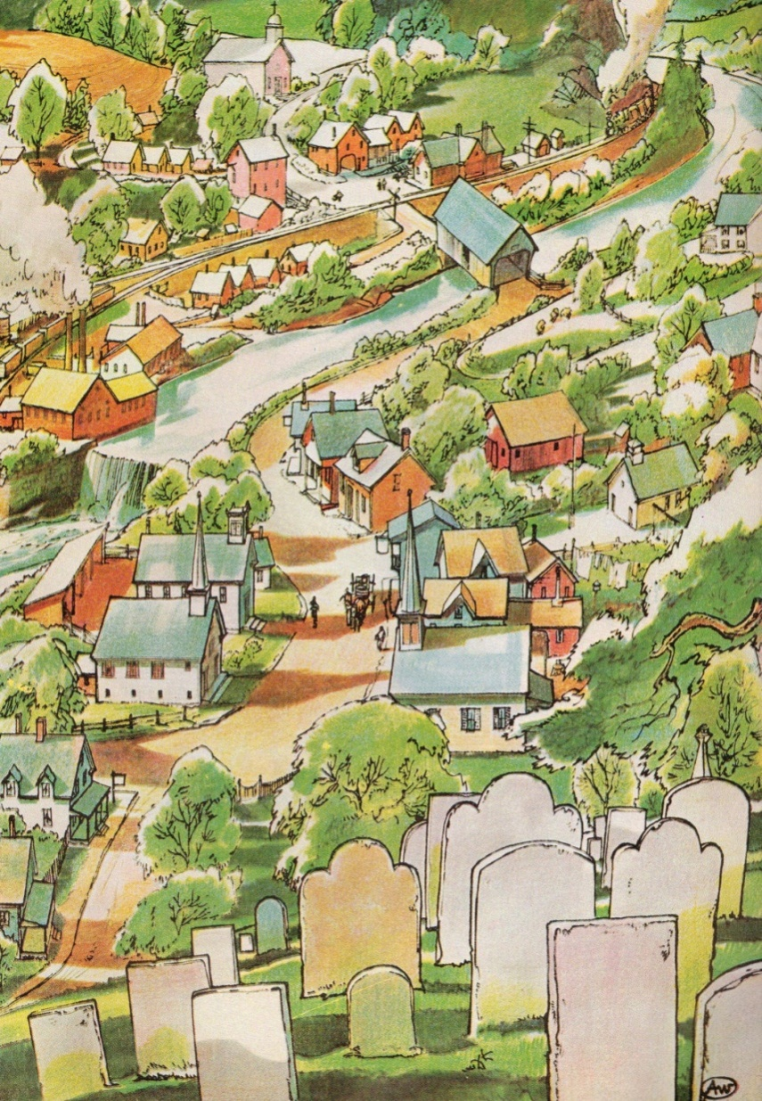
New England Colonies
Facts
People in New England towns lived, worked, and worshiped close together.
People used a barter system instead of money. This means to trade goods.
The meetinghouse was the most important building in the town.

Slide 7
New England Colonies
Facts
Women and girls spent hours cooking and preparing food.
They churned butter and dried fruits. This food was stored to last through the winter. They used animal fat to make candles and soaps.
The men would hunt and work in the fields. They also made their own tools.

Slide 8
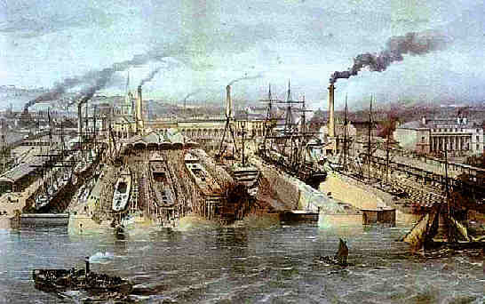
New England Colonies
By 1750, busy cities cropped up around the New England colonies.
Some colonists lived in small towns surrounded by farm land outside of the big cities.

Slide 9
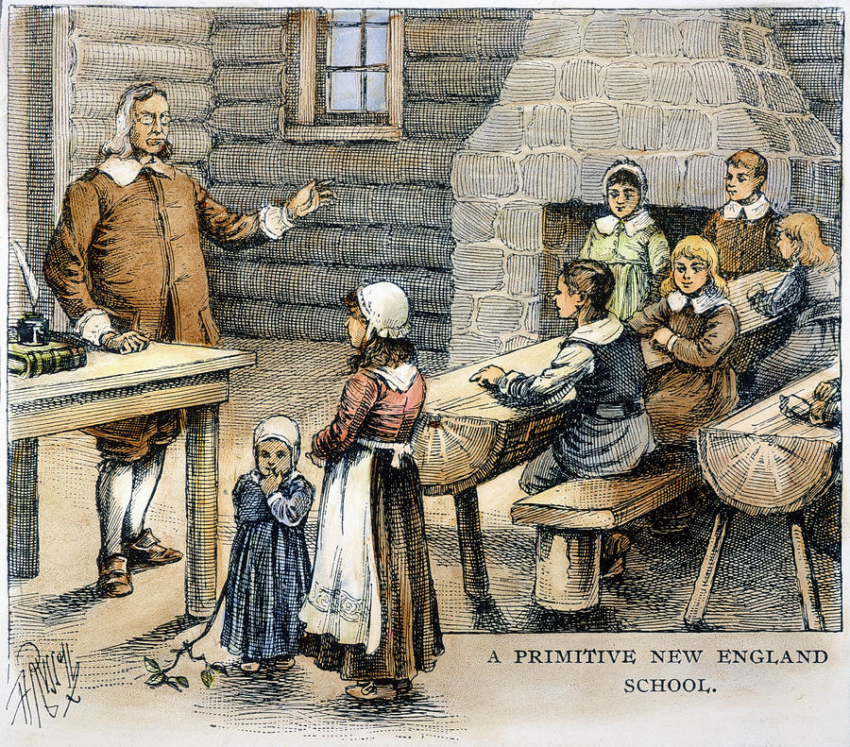
New England Colonies
School
One room
One teacher
Very strict, children were often whipped for punishment
The main subject was reading

